Slide 1
Scuba diving experience VR
2조 깨비드릴조
20164264 최지영
20164271 김미소
20164289 장혜진

Slide 2
INDEX
Task Background
Goal of Task
Task Result
Expected Effectiveness and Utilization Plan

Slide 3
· Task Background ·
Reasons and Necessities for Topic Selection
- Usually, it takes time and material investment to experience scuba diving once.
- Therefore, I hope that I can get the information that I need easily through games and prepare in advance to enjoy as much or more as I invest in it.
- I think I need content to help me familiarize myself with the instructions I need in advance.

Slide 4

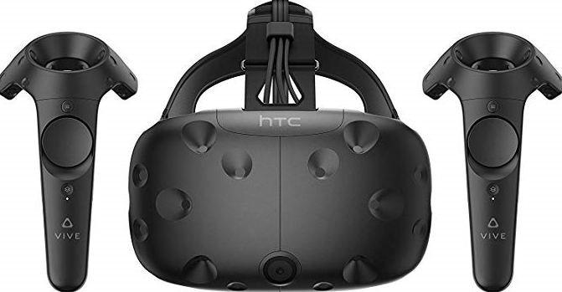

· Task Background ·
use environment
- Unity
- HTC VIVE
- Steam VR
-Windows 10 Education
-32GB, 64bit 운영체제

Slide 5
· Goal of Task ·
Scuba diving experience VR
Since it usually takes time and physical investment to experience scuba diving once, games allow you to easily acquire the necessary information and prepare in advance.
Name of wearing equipment, use sign, etc… Use VR to provide visual and sensory effects for easier and fun learning.

Slide 6
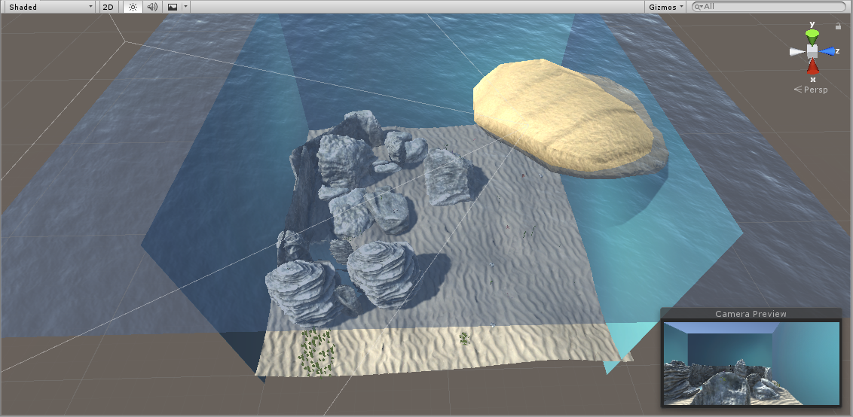
· Task Result ·

Slide 7
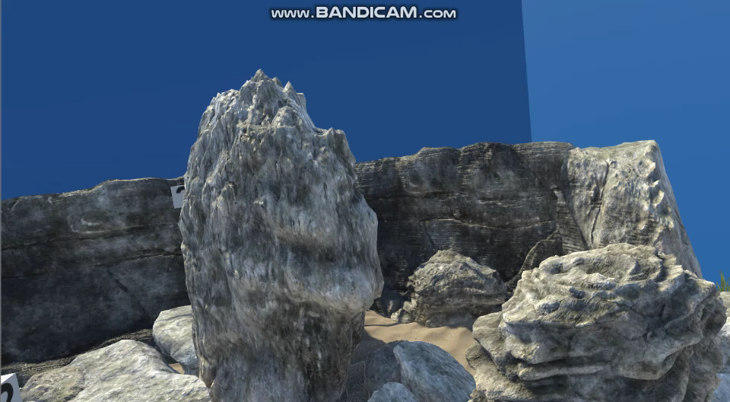
· Task Result ·
Show quiz in HTC Vive screen (VR screen)

Slide 8
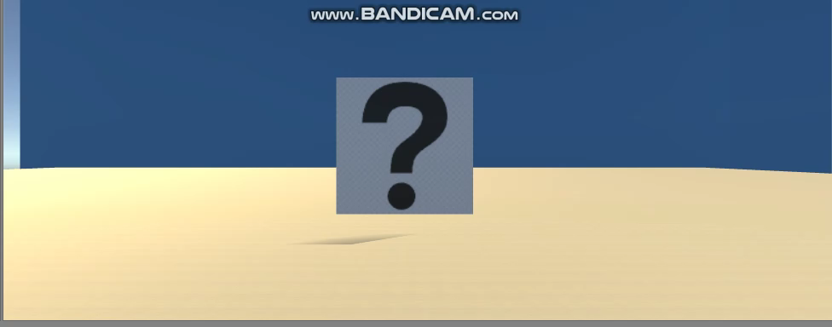
· Task Result ·
quiz interaction

Slide 9
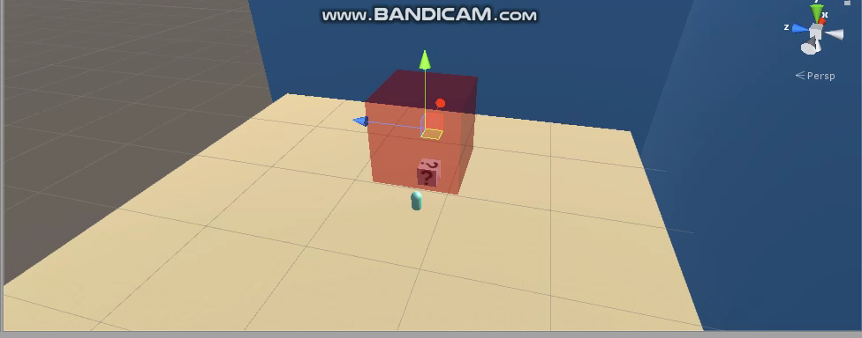
· Task Result ·
After solving quiz and fish interact with UI

Slide 10
· Expected Effectiveness and Utilization Plan ·
Before experiencing scuba diving, users can acquire some necessary theoretical knowledge in advance.
Visitors can also use it for educational purposes before entering the water at the scuba diving experience site.

Slide 11
GIT HUB
https://github.com/misocorea/smile1ms

Slide 12
Q & A

Slide 13
THANK YOU

